Slide 1
US Income Inequality
STAT 515 Redesign Project
Doug Cady

Slide 2
Original Graphic

Slide 3
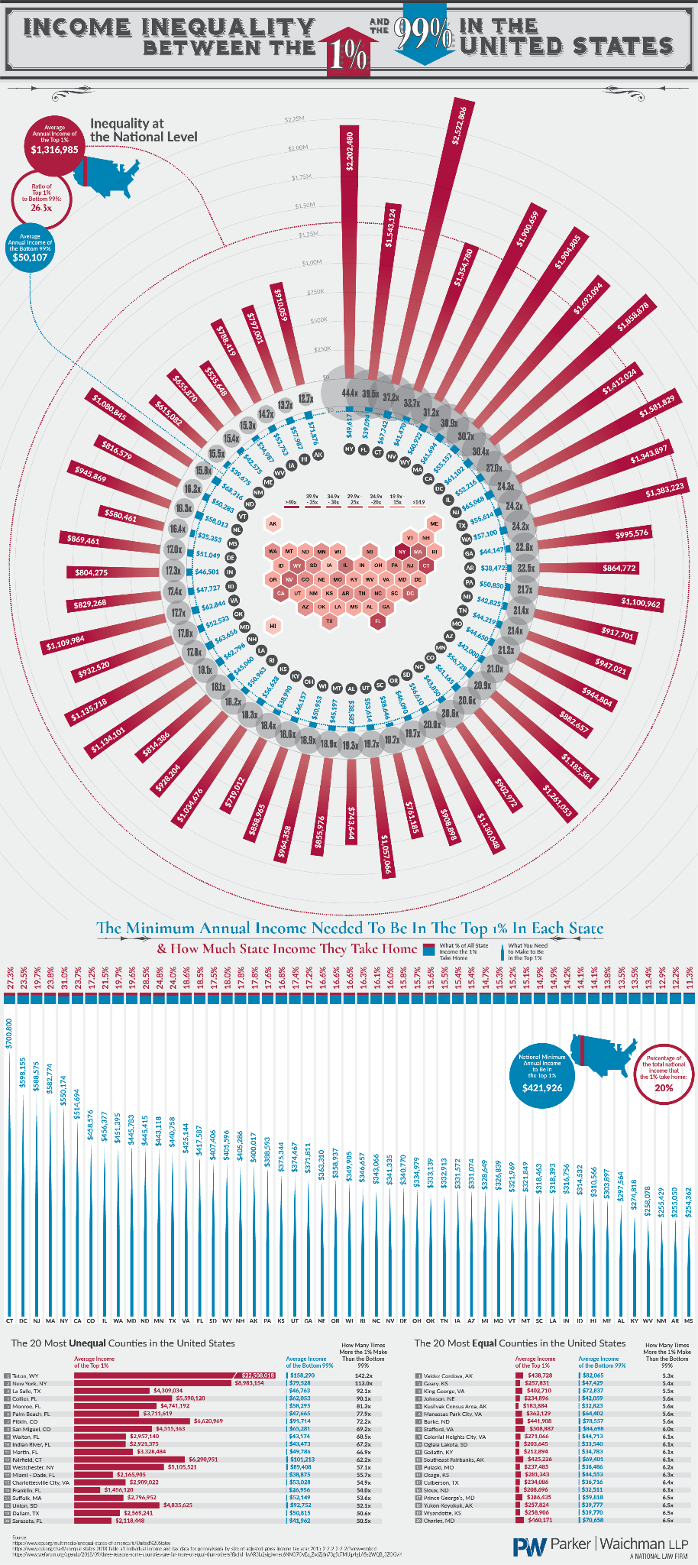

Slide 5
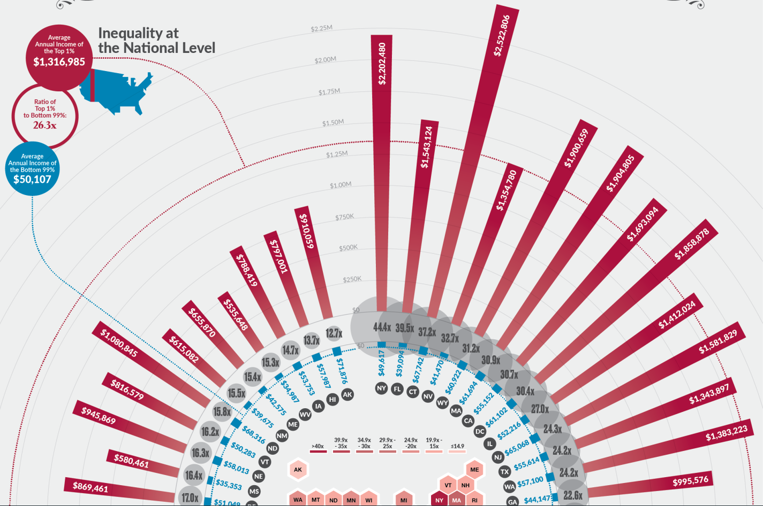

Slide 6
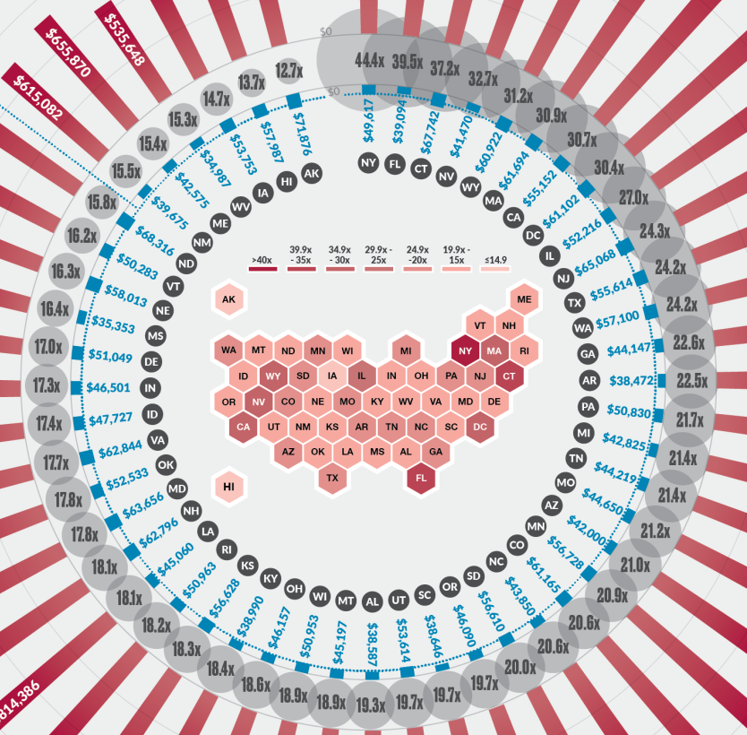
Original Graphic Analysis
Pros
Hexbin choropleth US state map
Consistent color usage - 1%, 99%
Sorted by appropriate values
Visually attractive
Length encoding
Cons
Labels are hard to read
Lack of inequality context (change over time)
Complexity with radial bar plot encoding

Slide 7
Special Efforts
Copy and paste tables from published report into Excel
Published report is a very long document

Slide 8
Redesigned Graphic

Slide 9
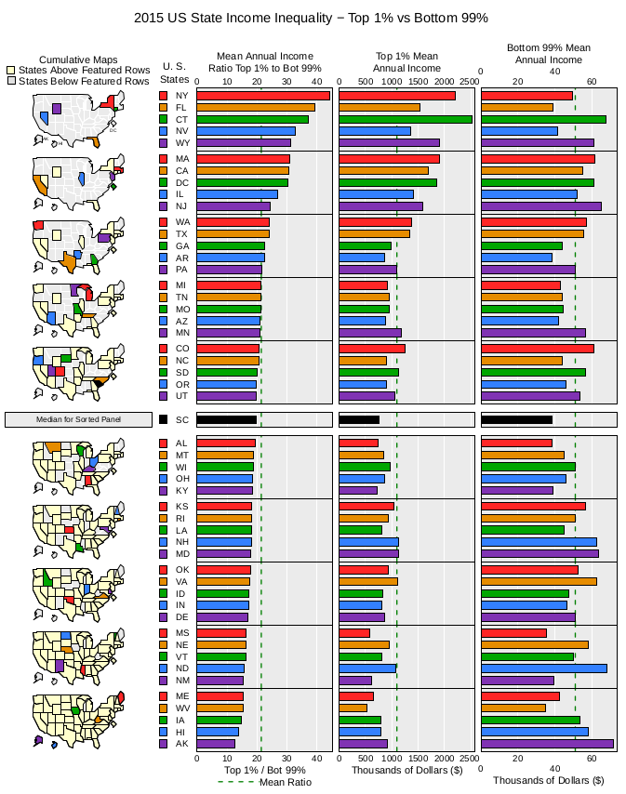
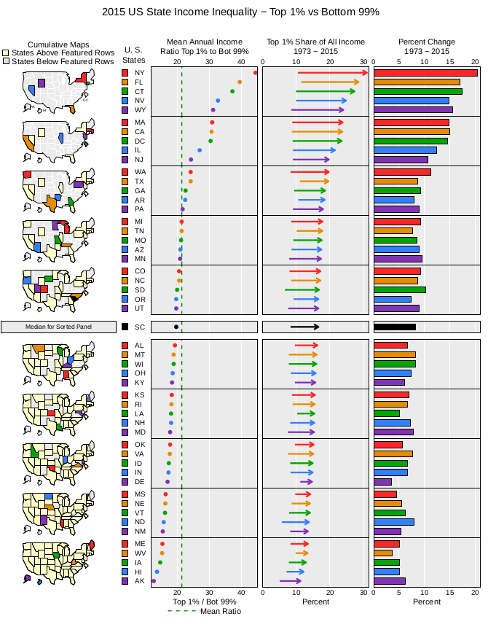
V1
V2

Slide 10
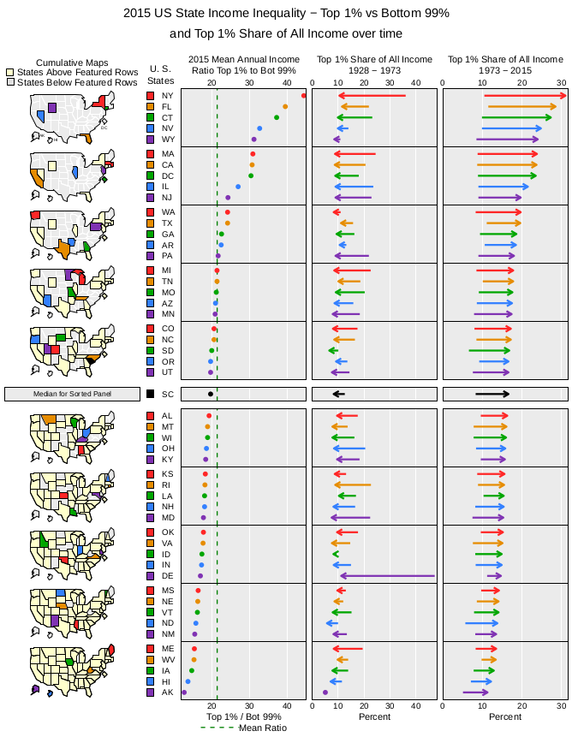
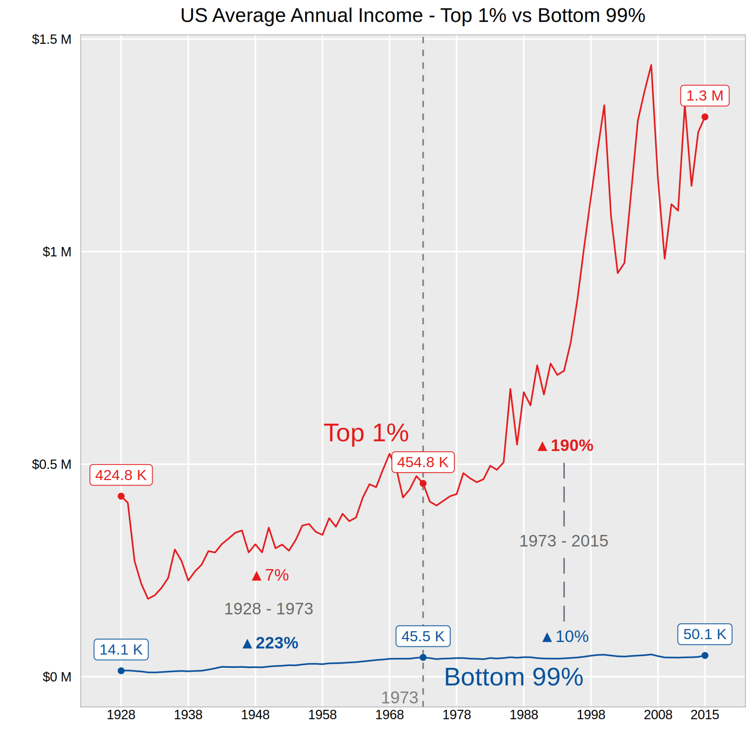
V3

Slide 11
Summary of Redesign Improvements
Better comparison among states
Inequality context - change over time
Can explore regional or geographic trends

Slide 12
Sources
Infographic: https://www.visualistan.com/2020/09/income-inequality-between-the-1-and-the-99-in-the-united-states.html
Source data: https://files.epi.org/pdf/147963.pdf

Slide 13
Conclusion

Slide 14
Next Steps
Explore factors that may be causing inequality in US nationwide
Include inequality predictor(s) in model and assess fit

Slide 15
JUNK..

Slide 16
Original Graphic Analysis
Pros
Hexbin choropleth US state map
Consistent color usage - 1%, 99%
Sorted by appropriate values
Visually attractive
Length encoding
Cons
Labels are hard to read
Lack of inequality context (change over time)
Complexity with radial bar plot encoding

Slide 17
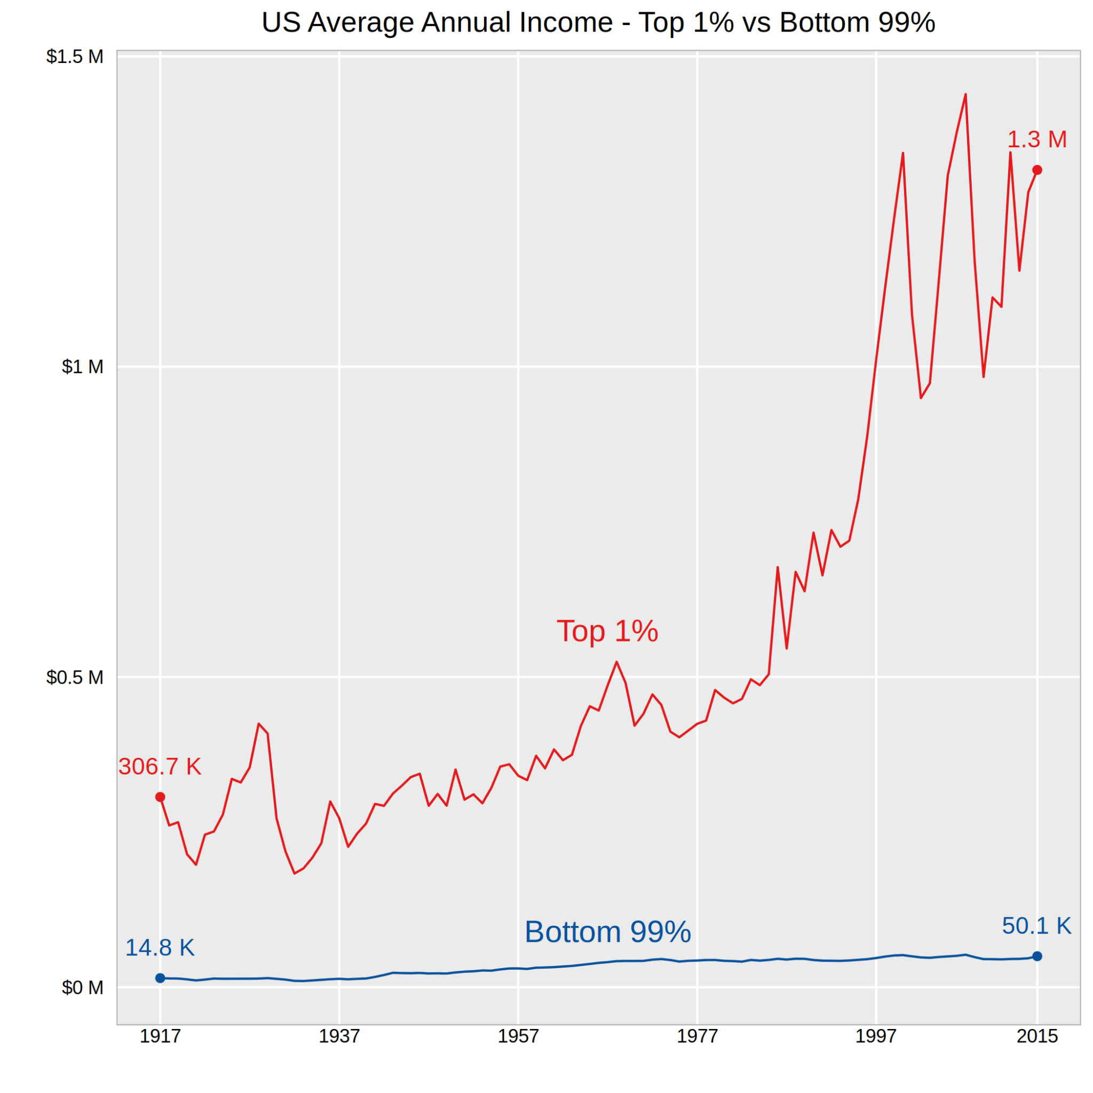
V3

